Slide 1

Business helicopter view
Adobe Systems
Adobe Inc. operates as a diversified software company worldwide, with three main segments: Digital Media, Digital Experience, and Publishing and Advertising. Founded in 1982 and headquartered in San Jose, California, Adobe provides its products and services directly to enterprise customers and end users through various channels, including its website, app stores, and a network of distributors and resellers
Size
Business segments
Financial performance
leverage
sales
EBIT margin
employees | sales per FTE
30k FTE | 0.6m
sales | EBIT (margin)
19.4bn USD | 6.7bn USD (34.5%)
market cap | net debt (of equity)
256bn USD | -3bn USD (-1.2%)
1.8x | 2.0x | 3.5x | 1.5x | 3.2x | 0.8x | 1.2x
19.4bn USD
CAGR L3Y | 15.5% | CAGR L5Y | 20.1%
Notes: Financials taken as of latest financial year end
Sources: FMP, Chat GPT

Slide 2
Business helicopter view
Adobe Systems
Adobe Inc. operates as a diversified software company worldwide, with three main segments: Digital Media, Digital Experience, and Publishing and Advertising. Founded in 1982 and headquartered in San Jose, California, Adobe provides its products and services directly to enterprise customers and end users through various channels, including its website, app stores, and a network of distributors and resellers
Size
Financial performance
Business segments
leverage
sales
EBIT margin
employees | sales per FTE
30k FTE | 0.6m
sales | EBIT (margin)
19.4bn USD | 6.7bn USD (34.5%)
market cap | net debt (of equity)
256bn USD | -3bn USD (-1.2%)
1.8x | 2.0x | 3.5x | 1.5x | 3.2x | 0.8x | 1.2x
19.4bn USD
CAGR L3Y | 15.5% | CAGR L5Y | 20.1%
Notes: Financials taken as of latest financial year end
Sources: FMP, Chat GPT

Slide 3
Investment actionability
Adobe Systems
Share price development
Liquidity
Some comment on the stock generated by Chat GPT
share price (left)
volume (right)
market cap | free float
256bn USD | []
adtv 90d | on-balance-volume
[] | []
Return profile
return L3M | dividend yield
[] | []
vola 90d | VaR L3Y
[] | []
Sources: FMP, Chat GPT

Slide 4
Cash flow dynamics
Adobe Systems
Key developments
Sources: FMP, Chat GPT

Slide 5
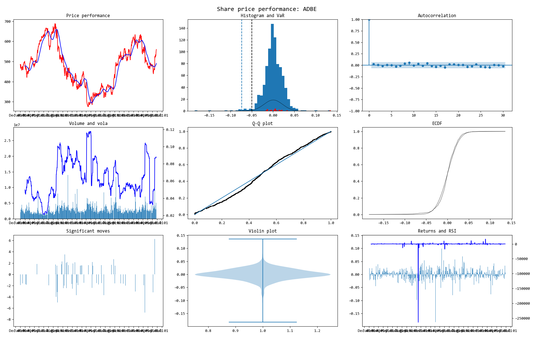
Price snapshot
Would be filled with stats
Adobe Systems

